Slide 1

CONTROL SYSTEM DESIGN AND ANALYSIS

Slide 2
Introduction
In frequency response (fr) approach to CS design and analysis, we vary the frequency of the input signal (most of the time a sinusoid) to the system (while keeping the amplitude constant) over a certain range and study the resulting steady-state (ss) response (output of the system).
We can use the data obtained from the measurement on the physical system without deriving the mathematical model... we can determine the transfer function of the system from its experimentally determined frequency response.
Magnitude and phase angle of the ss response can be represented graphically to provide insight for the analysis and design.

Slide 3
Let us note the following:
Root locus method:
  Inability to deal with more than one variable at a time.
  Difficulty dealing with systems with time lags (time of travel of information, fluid, etc to flow in a system).
FR method:
  Dominant pole locations in the s-plane imply time-domain response in terms of un-damped natural frequency and damping ratio.
  Frequency domain figures-of-merit are related to dominant pole locations and therefore to the time domain; relation is, however, not explicit.
  no relationship between the transient response in time domain and various fr plots for systems with orders higher than 2.
  Can handle higher-order systems, complex controller dynamics and time lags.

Slide 4




ss response to sinusoidal input
Given a stable, LTI(linear time-invariant) system, G(s), and sinusoidal input, x(t), then the LT of the output, y(t), is Y(s).
After waiting until ss conditions are reached, the fr is obtained by letting s=jw for G(jw) to be determined; M is the amplitude ratio of output/input and phi the phase shift between input and output sinusoids
G(jw) is the sinusoidal tf.

Slide 5
Presenting fr characteristics in graphical form
G(jw), the sinusoidal tf, can be presented in 3 graphical forms:
  Bode diagram or logarithmic plot.
  Nyquist plot or polar plot.
  Log-Magnitude vs phase plot (Nichols plot)

Slide 6
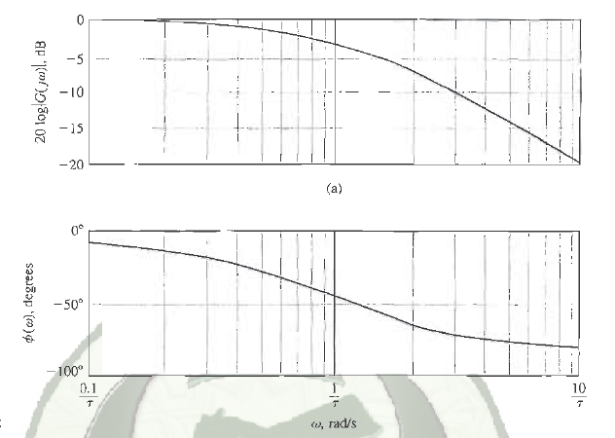


Bode plot
Made up of 2 plots ( M in decibels and phi in degrees) plotted against frequency on a log scale.

Slide 7
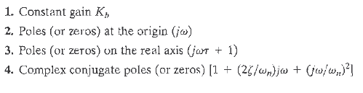






Bode plot - cont
4 different kinds of factors can be found in G(jw)

Slide 8
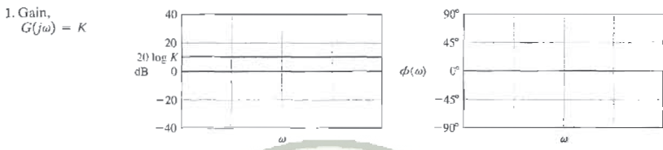
Asymptotic curves for basic terms of tf

Slide 9
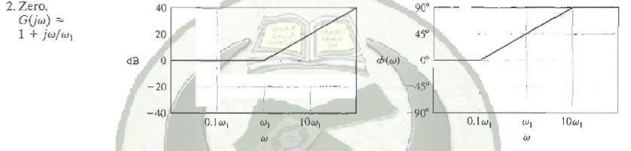
Asymptotic curves for basic terms of tf

Slide 10
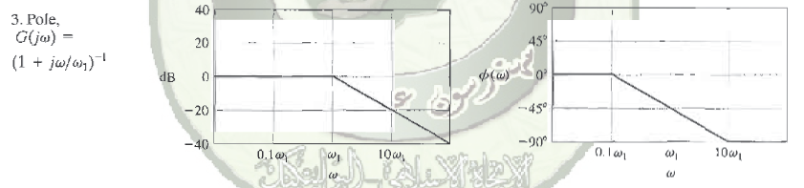
Asymptotic curves for basic terms of tf

Slide 11
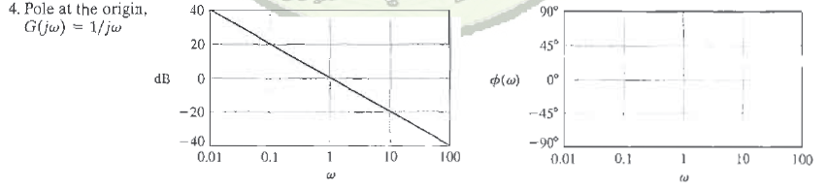
Asymptotic curves for basic terms of tf

Slide 12
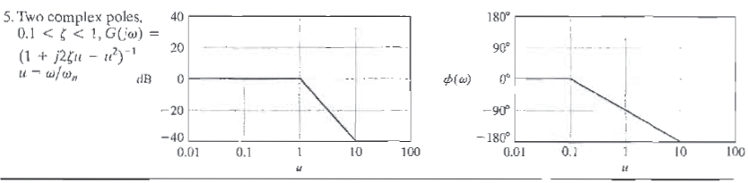
Asymptotic curves for basic terms of tf

Slide 13

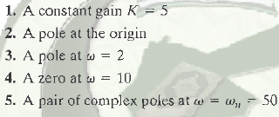
Bode plot-example

Slide 14


Bode plot-example

Slide 15
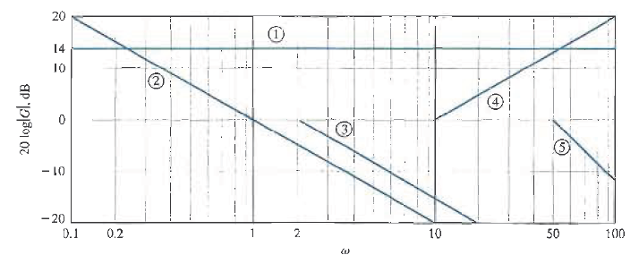
Bode plot-example

Slide 16
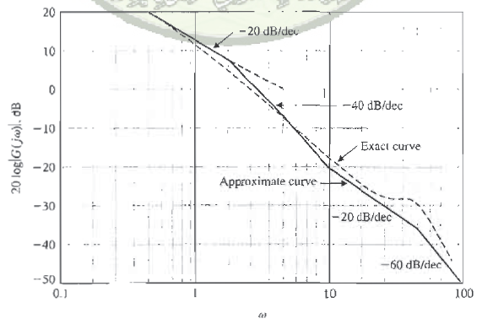
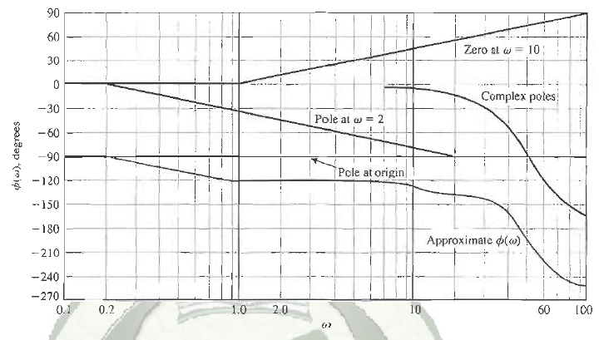
Bode plot-example

Slide 17
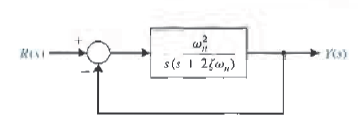
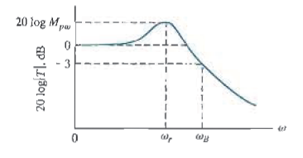
Performance specs in freq domain
At resonant freq, w_{r} ,a max value of response, Mpw is attained.
The bandwidth, w_{B} is a measure of a system’s ability to faithfully reproduce an input signal.
At w_{B}, freq response reduces by 3 dB from its low freq value.

Slide 18
Performance specs in freq domain
w_{r} and the -3 dB bandwidth relate to the speed of the transient response; as w_{B} increases, rise time of the step response of the system decreases.
Overshoot to a step input relates to Mpw through the damping ratio.

Slide 19
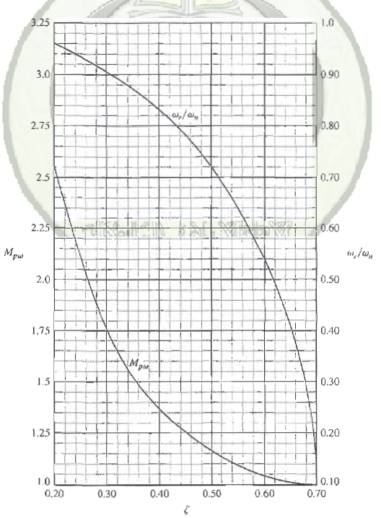
Performance specs in freq domain
w_{r} and the -3 dB bandwidth relate to the speed of the transient response; as w_{B} increases, rise time of the step response of the system decreases.
Overshoot to a step input relates to Mpw through the damping ratio; as Mpw increases in magnitude, overshoot increases.

Slide 20
Log magnitude and phase diags
We can represent the freq response in another way:
Plot the log magnitude in dB versus the phase angle for a range of frequencies.
This information is equivalent to that portrayed by the Bode diag; it is easier then to obtain the Bode diag and transfer the information to the coordinates of the log magnitude versus phase diagram.

Slide 21
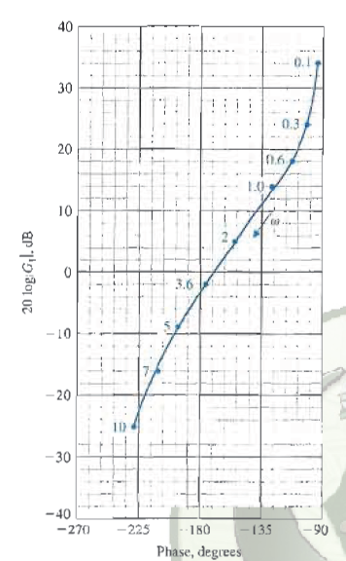

Log magnitude/phase ang plot-example

Slide 22
Stability in frequency domain

